Slide 1


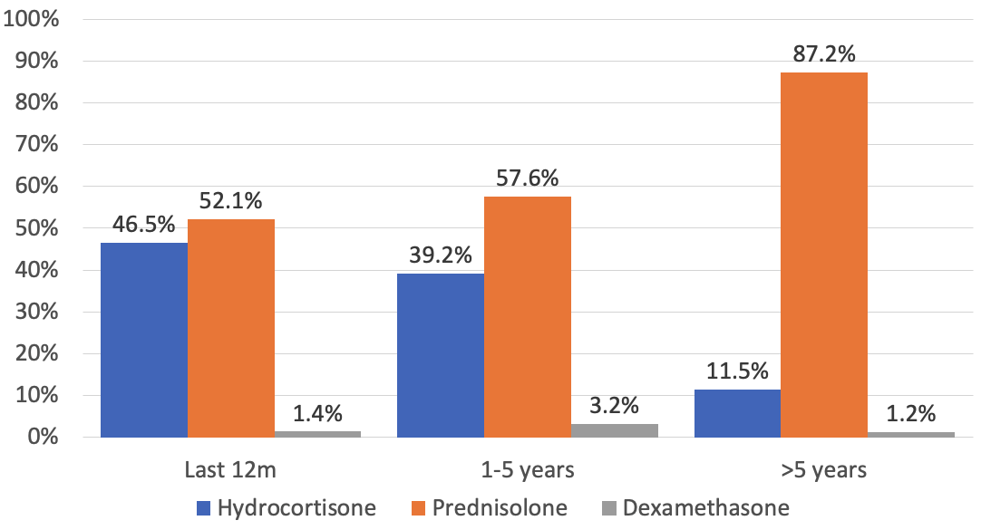
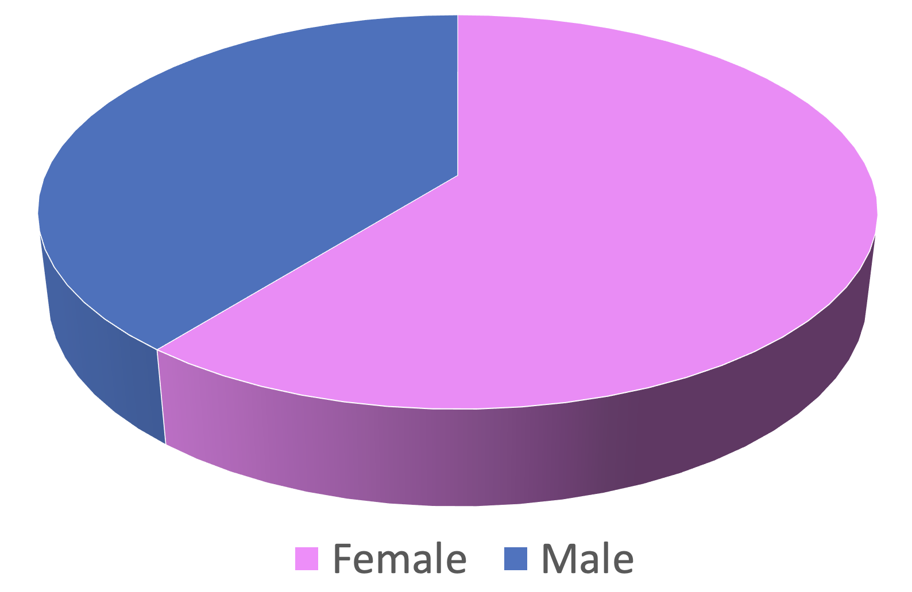
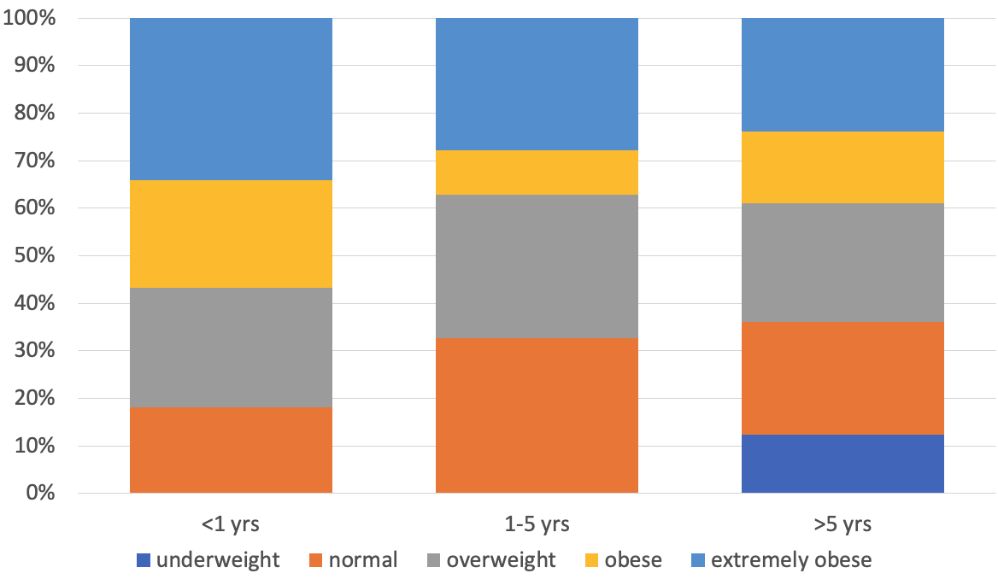
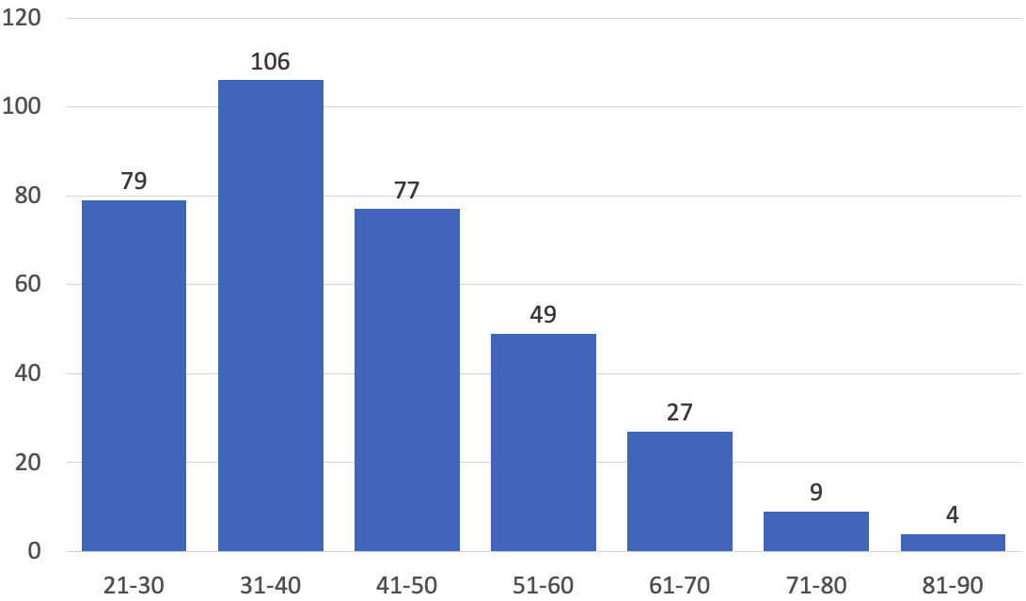
Implementing the study into health status in adults with CAH in the UK and Ireland – CaHASE2
CAHASE2 investigators of the Society for Endocrinology
Introduction and Objectives
Figure 3. Glucocorticoid use in recorded cases
Congenital adrenal hyperplasia (CAH) is one of the commonest forms of primary adrenal insufficiency with an incidence of about 1 in 15,000. More than 10 years ago, several studies highlighted the suboptimal health status and care provision in adults with CAH that were associated with significant co-morbidities in relatively young adults. In 2023, we implemented CaHASE2 to develop a strategy for prospective collection of longitudinal data. Our recent CAH service evaluation suggested significant differences in the approach to CAH patients. The current key aim of the study is the identification of specific unmet needs, through standardised clinical data collection across all participating centres.
Percentage of different glucocorticoids
used in each time period
Methods
Ongoing 3-year project, using I-CAH registry data (https://sdmregistries.org/) on adults with 21-hydroxylase deficiency from the UK and Ireland.
Longitudinal collection of minimal data set over initially 3 years and beyond.
To explore variations in care provision between centres, and assessment of potential differences in outcomes.
In September 2023, PIs agreed a minimal dataset for the collection of real-world data for participating centres that included;
Age and Sex
Co-morbidities (including medications)
Height, weight, BMI
Fertility / pregnancy / menstrual irregularity
Blood pressure
Glucocorticoid +/- mineralocorticoid replacement therapy (dose, timing compliance)
Biochemical & hormonal biomarkers (e.g. U&Es, 17OHP, androstenedione, testosterone,
renin, lipid profiles, HbA1c and blood glucose)
Genotype (if available)
Preliminary data collection and analysis suggests that there might be a temporal change in used glucocorticoids over time.
Figure 4. CAH biomarkers, 17OHP and androstenedione
Results
17OHP nmol/L
Androstenedione nmol/L
8 nmol/L
Figure 1. Patient recruitment
36 nmol/L
Centre | Number of patients | Total number of visits
A | 1 | 21
B | 2 | 79
C | 21 | 73
D | 137 | 137
E | 2 | 38
F | 53 | 129
G | 35 | 168
H | 1 | 1
I | 18 | 226
J | 13 | 138
K | 17 | 115
L | 4 | 11
M | 3 | 3
N | 9 | 10
O | 3 | 12
P | 22 | 22
Q | 9 | 29
R | 1 | 1
Total: 18 | Total: 351 | Total: 1213
18 centres
351 patients
recruited to I-CAH
12 nmol/L
138
Preliminary 17OHP data suggests that a significant proportion of patients might be overtreated.
213
Figure 5. BMI classifications
CaHASE2 was launched in November 2023. Currently, 18 centres from UK and Ireland are participating. In total 351 adults (213 females, 138 males) with CAH have been recruited
Percentage of patients in different BMI categories in each time period
Figure 2. Age categories
A significant proportion of CAH patients with CAH recruited are overweight or obese.
Summary and Future Work
This project will provide important information about the health status of CAH patients and how this might be related to differences in health care provision. Ultimately, such national data should lead to a higher degree of equality of service provision in all parts of the UK and Ireland.
The data will be analysed after the first completed 12 months cycle, and annually thereafter to assess the current level of care provision and inform the development of national CAH standards. In addition, we will establish a report that will provide centres with information about their local care provision in relation to other centres.
There is a preponderance of younger to middle-aged adults in the patient cohort that has been currently recruited. We will understand over time how representative this distribution is in relation to patient cohorts cared for in the UK and Ireland.
Acknowledgements: We thank the patients for their participation in this study, all participating centres and the I-CAH registry for providing the data.
More Information about CAHASE2 is available online:
https://www.endocrinology.org/clinical-practice/research-projects/cahase-2/
Contacts for queries and joining CAHASE2
n.krone@sheffield. ac.uk; r.welch@sheffield.ac.uk
jessica.davis@endocrinology.org; grace.okoro@endocrinology.org

