Slide 1
UK Acromegaly Register:
Past, Present and Future
Dr Claire Higham
Consultant Endocrinologist, The Christie Hospital NHS FT
Honorary Senior Lecturer, University of Manchester

Slide 2
SfE BES 2022- Conflict Of Interest
Name: Claire Higham I declare that I have no potential conflict of interest.

Slide 3
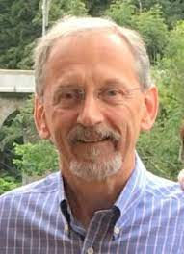
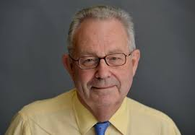
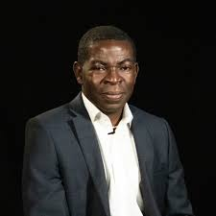
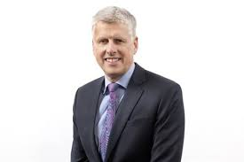
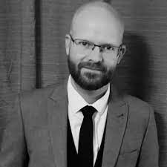
UKAR Past History
Initiated in 1997
Society for Endocrinology involvement 2002
Ethics approval (CRN support) as registry 2006
Sponsor: Christie NHS Foundation Trust
Chief Investigator: Professor Peter Trainer
Previous Funding:
Clinical Endocrinology Trust
Ipsen
Novartis
Pfizer
Pharmacia
Recruitment 1997-2017 (20 yrs)
Follow-up recordings stopped 2018
Registry on temporary halt 2020

Slide 4
UKAR
Acromegaly
4-6 new cases per million per year (UK approx. 350 cases/yr)
Prevalence 40-60 per million (UK approx. 3,500 cases)
3563 patients (one of largest global registries)
809 deceased
52 discharged
288 lost to follow-up
38 moved address
Notes:
For example the Liege Acromegaly Survey resgistry has around 3,200

Slide 5
UKAR
Aims
to gather prospective and retrospective data on a large series of patients with acromegaly in UK
to use the data to provide epidemiological data about long term mortality and morbidity in acromegaly
to provide data on results of treatment by surgery, radiotherapy and medical therapy
to disseminate data in peer reviewed journals, conferences and feedback to patient support groups
to encourage centres to audit own practice against national dataset
Methods
Observational, non interventional study
Patient consented and data collected at routine clinic appointment
entered into central database
Local and Centralised (IDS) IGF-1/GH measurements
Data linked to HSIC data: death and cancer registry

Slide 6
Past Publications
Conventional pituitary irradiation is effective in lowering serum growth hormone and insulin-like growth factor-I in patients with acromegaly Jenkins PJ, Bates P, Carson MN, Stewart PM, Wass JA.. J Clin Endocrinol Metab. 2006 Apr; 91(4): 1239-45
Wide variation in surgical outcomes for acromegaly in the UK Bates PR, Carson MN, Trainer PJ, Wass JA; UK National Acromegaly Register Study Group (UKAR-2).. Clin Endocrinol 2008;68(1):136-42.
Control of GH and IGF1 in acromegaly in the UK: Responses to medical treatment Howlett TA, Willis D, Walker G, Wass J, Trainer PJ & UK National Acromegaly Register Investigators 2012.. ICE/ECE 2012 P1427. PMID:23574573
Control of growth hormone and IGF1 in patients with acromegaly in the UK: responses to medical treatment with somatostatin analogues and dopamine agonists. Howlett TA, Willis D, Walker G, Wass JA, Trainer PJ; UK Acromegaly Register Study Group (UKAR-3). Clin Endocrinol (Oxf). 2013 Apr 11. doi: 10.1111/cen.12207.
Radiosurgery is Effective for the Treatment of Acromegaly. Robins, James & Ayuk, J. & Trainer, P. & Newell-Price, John. (2014). Stereotactic Gamma Knife Journal of Neurological Surgery Part B: Skull Base. 75.
Notes:
See that the last publication was some time ago.
Radiotherapy, surgery, medical treatment

Slide 7
UKAR Present
Steering Group recommenced 2020
Review/approve/decline requests for data
Review/approve/decline abstracts/manuscripts before submission
Determination of whether registry should re-open/close
Current Committee
Dr Claire Higham : chair and CI (since 2021)
Dr John Ayuk
Professor John Wass
Dr Tara Kearney
Dr Prakash Abraham
Dr Daniel Flanagan
Dr Stephen Orme
Professor Maralyn Druce
Dr Steven Hunter

Slide 8
UKAR Present
Steering Group recommenced 2020
Review/approve requests for data
Review/approve abstracts/manuscripts before submission
Determination of whether registry should re-open/close
Collaborations
Netherlands: “discharge after successful trans-sphenoidal surgery”
Dr van Beek
international, multicenter, evidence-based guideline for discharge of acromegaly patients
from endocrine follow-up after successful transsphenoidal surgery based on recurrence risk and presence of hypopituitarism.
Ongoing Projects
GH/IGF-1 measurement and assays (Phil Monaghan)
GH/IGF-1 discrepancy and mortality (John Wass)
Mortality and morbidity (Steve Orme)
Gigantism (Marta Korbonitz and John Wass)

Slide 9
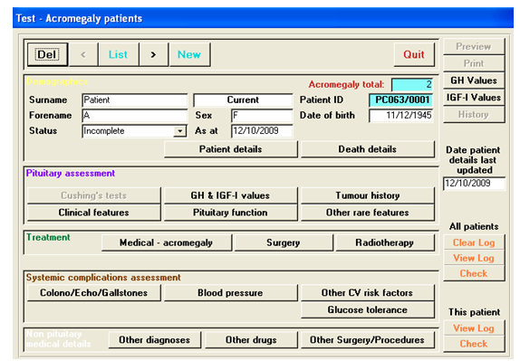
What information is in the UK dataset?
Baseline Characteristics
Clinical features
Tumour characteristics and imaging
GH and IGF-1 results
Pituitary function
Other rare features
Co morbidities
Cardiovascular and metabolic (echocardiogram, CV (BP etc) and diabetes markers)
gallstones
oncological (colonoscopy)
Treatment Characteristics
Surgery (type, date, complications, histology)
Radiotherapy (type, date)
Medical Therapies (type, dose, duration)
Longitudinal data
GH and IGF-1 (local and centralised)
recurrence
evolving complications, medications

Slide 10
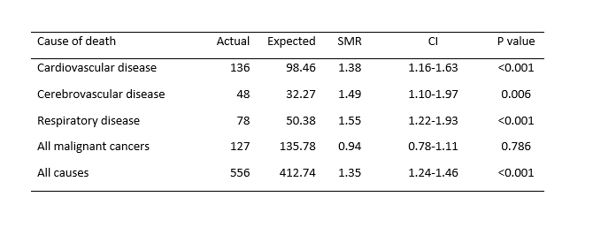
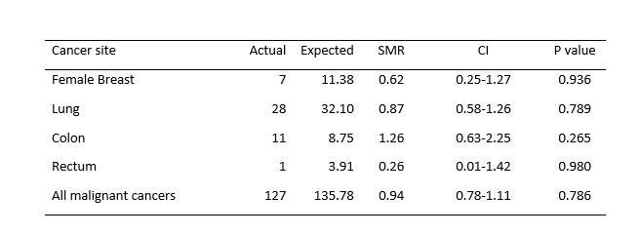
Increased mortality in acromegaly is mainly due to vascular and respiratory disease
and is normalised by control of GH secretion
Mortality Data
n= 1845
1970-2016
Cancer Mortality Data
Linkage to NHS Digital Health and Social Care Information Centre - GOV.UK
Orme SM, McNally R, et al.. J Endocr Soc. 2020;4(suppl 1):SUN-LB48.
Notes:
Abstract presented at the American Endocrine Society in 2020
All cause mortality is increased in acromegaly over this period in UK
Excess mortality related mainly to vascular disease
Although respiratory disease also contributes
And happens in the first 5 years
Always a lot of concern about cancer in acromegaly, with the theoretical and in vitro supported evidence that GH is facilitatory
But these important data show that there is no increased risk of mortality from any cancer in acromegaly and indeed Steve Orme tells me, any increase in cancer incidence

Slide 11
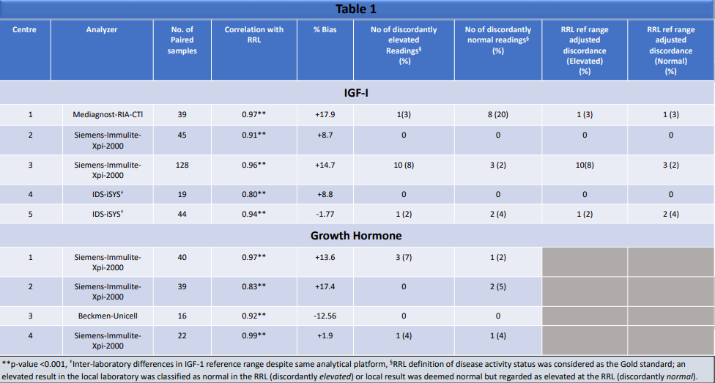
The impact of variations in laboratory measurements of IGF-1 and random GH on the
classification of acromegaly disease activity status:
Lessons from the UK Acromegaly Register Reference Laboratory
5 local centres
4 different assays
good correlation
reference ranges
Bashir et al Endocrine Abstracts (2020) 70 AEP657 | DOI: 10.1530/endoabs.70.AEP657
Notes:
Another study presented in abstract form at ECE 2020

Slide 12
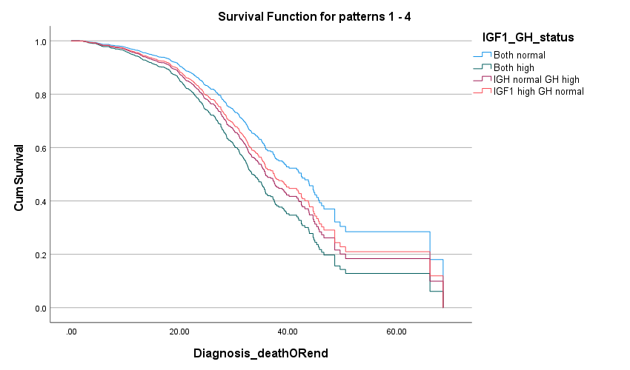
Discordant growth hormone and insulin like growth factor-1 values are associated with an increased mortality over concordant normal values in patients treated for acromegaly
n = 2138
41,331 person-yrs follow up
29 centres
1210 normal GH and IGF-1
326 high GH and high IGF-1
429 high GH normal IGF-1
173 normal GH high IGF-1
Abeyaratne D et al EndocrineAbstracts (2021) 77 OP3.1 | DOI: 10.1530/endoabs.77.OP3.1
Notes:
BES 2021

Slide 13
Registry Data: Quality of Data
IGF-1 reported without units or with incorrect units
No local reference range provided for IGF-1
Discrepancy in reporting IGF-1 as “high” when actual value within limits
request to all participating sites to update local IGF-1 data inputs with units and RR from the sample time
request to all participating sites to supply assay type/units/reference ranges across the time frame

Slide 14
UKAR Future
Global Acromegaly Registry (UK data provided)
John Ayuk
submission of research questions to global dataset
Unanswered questions from current dataset
submit proposals/discuss with UKAR committee
clinical@endocrinology.org
Open UKAR database again
enthusiasm
funding
updating and extending dataset
personalised care approach PROMS/QOL
biochemical parameters/quality of data entry
developing/auditing standards of care
coding and linkage to national datasets

Slide 15
Project Update
Global Acromegaly Registry
2
Prospective Sites
(New Registries)
2
Retrospective Data Partners
(Existing data integrated)
5789
Unique Patients Entered
Live Sites
Korea Severance Hospital launched June 13th, 2022
Additional Korean sites coming onboard this year!
Oregon Health & Science University launched October 24th, 2022
Data Mapping and Integration
AcroStudy data is available for research
Retrospective UK data mapping is in progress
Other Progress
Liege Acromegaly Study contracting in progress
Austria Contracting in progress
US: MGH & Barrow Neurological Institute program development underway

