Slide 1



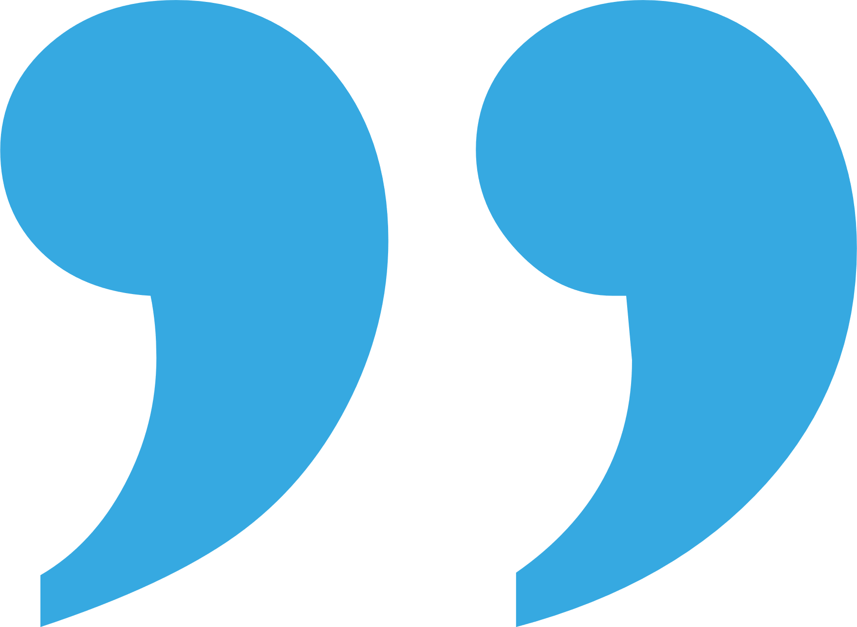
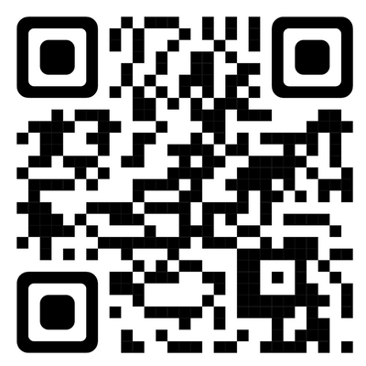




Student Media Award 2025
Passionate about science communication and busting myths?
Enter the Society for Endocrinology’s Student Media Award and show off your skills, whether that’s videos, blogs, podcasts, or graphics - for a chance to win up to £300!
The content should explore one of
the following subjects:
  Cortisol
  Thyroid
  Progesterone
More info and
media guidelines
Closing date
10 November 2025

